Slide 1
HouseHunt ER Diagrams

Slide 2
Entity Name | Entity Primary Attributes
User | _id, email, username, password, avatar, role
Post | _id, title, price, images, address, city, bedroom, bathroom, latitude, longitude, type, property, userId
PostDetail | _id, desc, utilities, pet, income, size, school, bus, restaurant, postId
SavedPost | _id, userId, postId
Chat | _id, userIDs (array), seenBy (array), lastMessage (optional), messages (array or separate relation to Message)
Message | _id, text, userId, chatId
Interaction | _id, user_id, post_id, interaction_type, message, scheduled_at
Review | review_id, user_id, post_id, seller_id, rating, comment,
Payment | payment_id, user_id, post_id, amount, method, status, paid_at, invoice_url
SupportTicket | ticket_id, user_id, payment_id, title, description, status
Type (reference) | _id, typeName, desc
Property (reference) | _id, propertyName, desc
Entitlement (reference) | _id, roleName, desc
Invoice | _id, post_id, user_id, invoice_date, amount, due_date, status, payment_method, desc
Team1 : HouseHunt
List of Entities

Slide 3
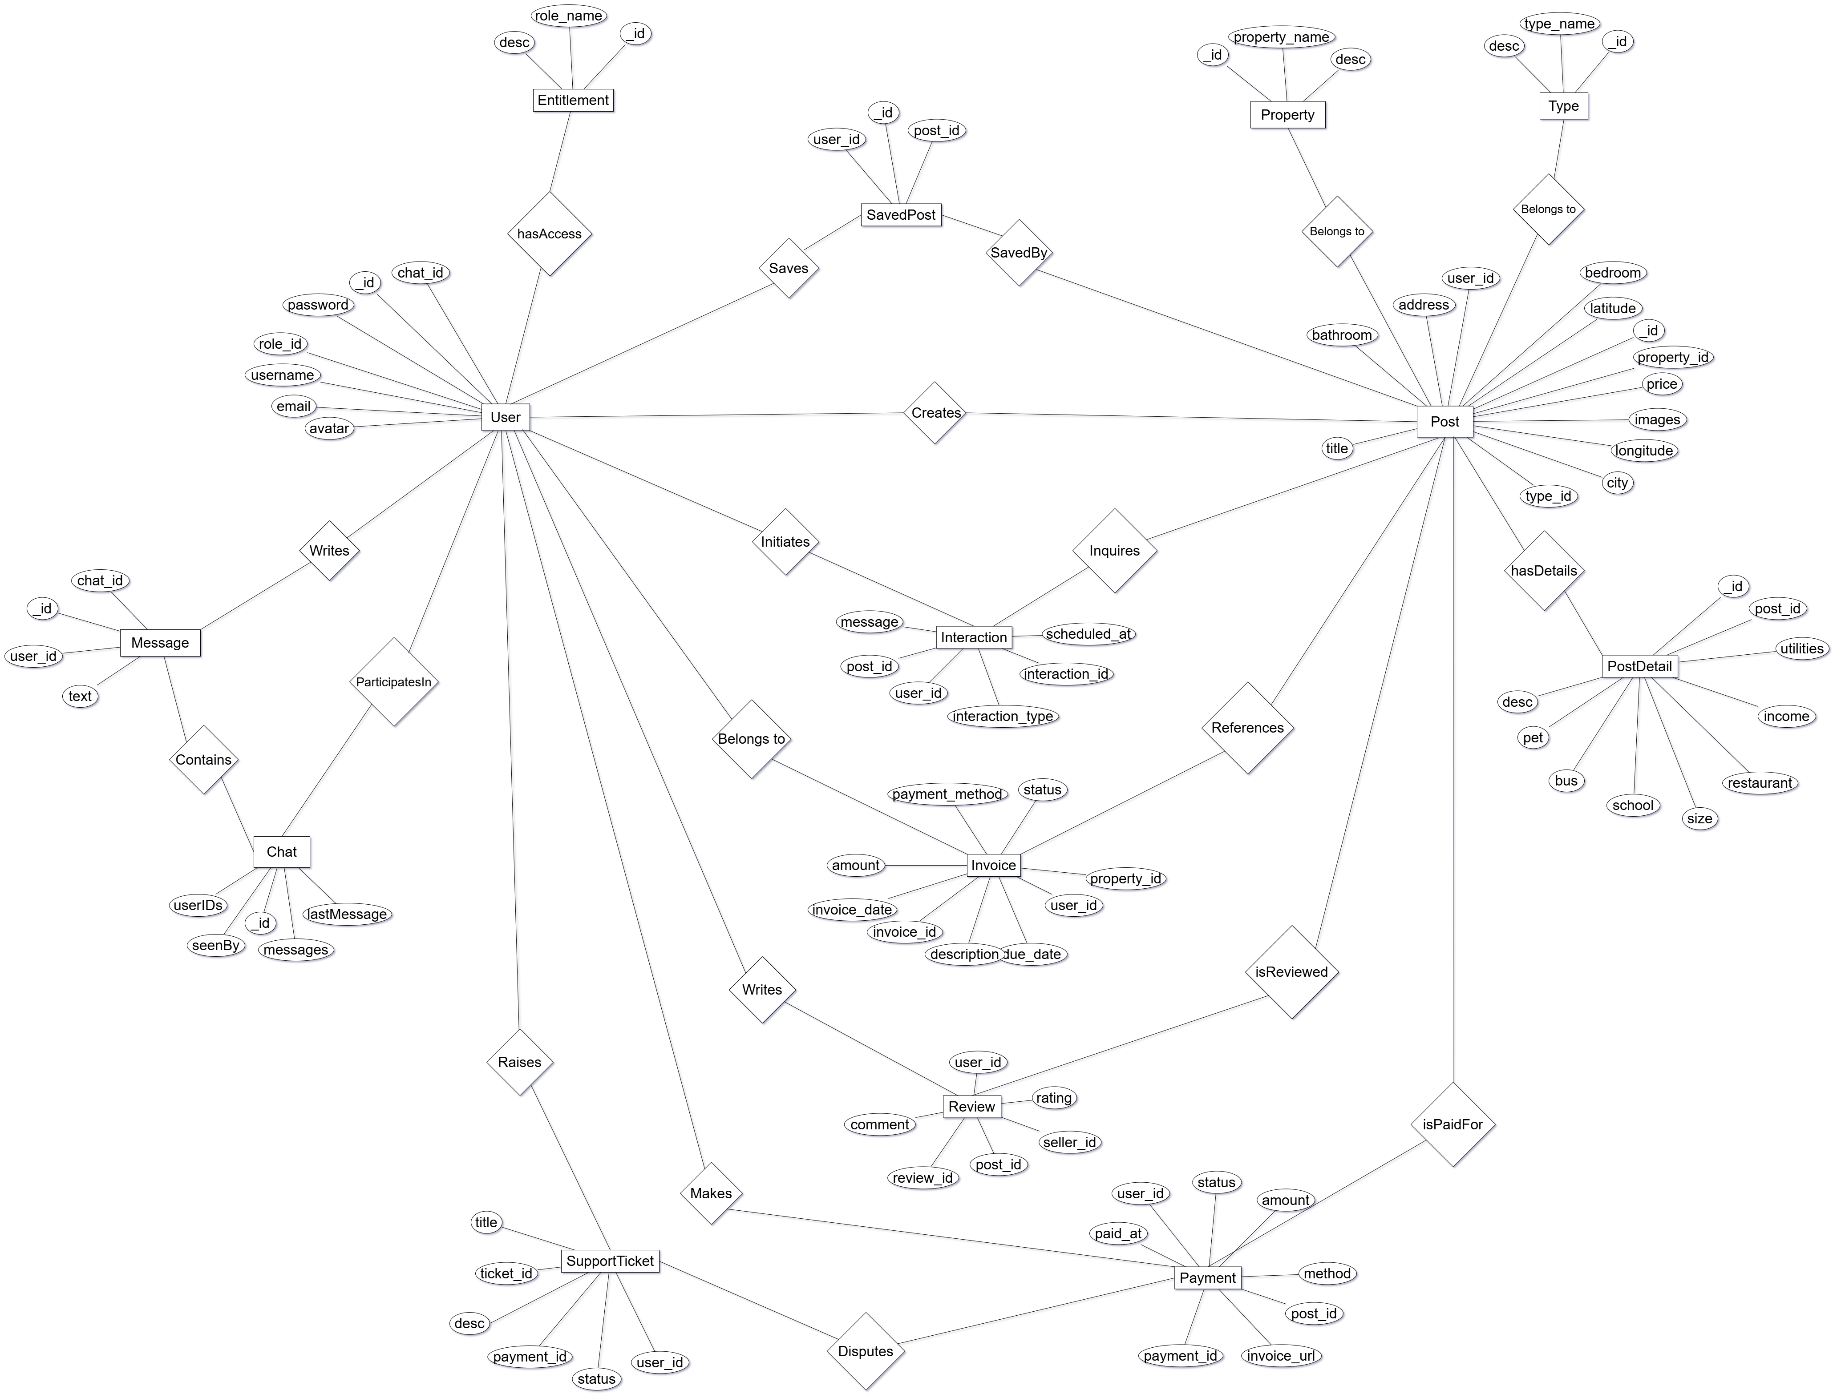
Team1 : HouseHunt
Conceptual ER Diagram

Slide 4
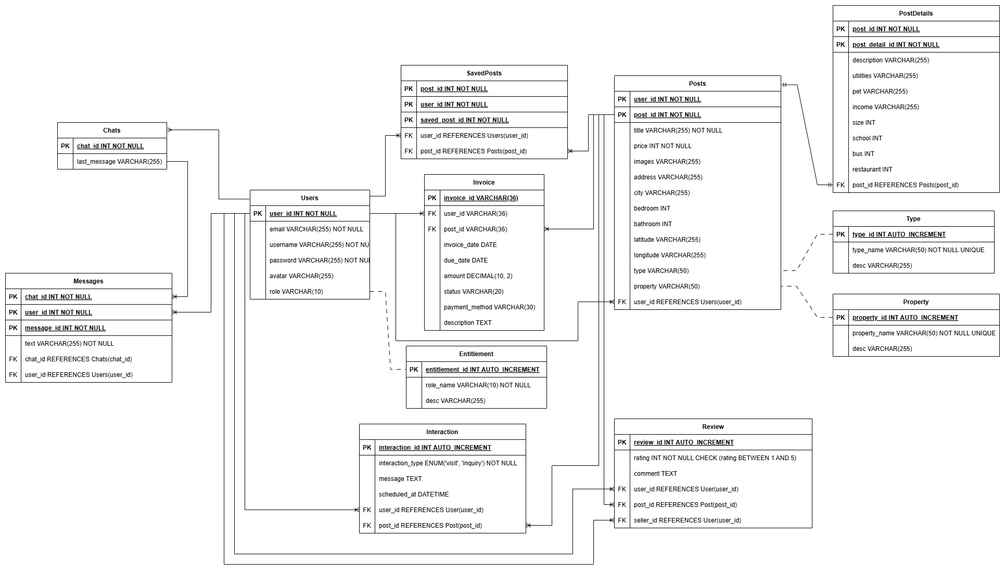
Team1 : HouseHunt
Logical ER Diagram
Reference Tables : Type, Property and Entitlement

